Slide 1

identify The Most Significant Factors that cause stress and anxiety in the society
OBJECTIVE

Slide 2

Approach :
Gathering data :
1. Through a survey
Demographic information (age, gender, location)
Stress and anxiety levels (using a standardized scale like the Perceived Stress Scale (PSS))
Factors contributing to stress (based on the list provided: work, financial, health, family, social, Educational, Life Changes, Technology, Cultural, Personal habbits )

Slide 3
Survey Questions:
Age:
Gender:
On a scale of 1-10, how would you rate your current stress level?
How frequently do you experience stress due to the following factors? (Rate each from 1-5)
Work-related stress
Financial stress
Health issues
Family and relationship problems
Social and environmental factors
Educational stress
Life changes and uncertainty
Technology and information overload
Cultural and societal pressures
Personal habits and lifestyles
Location:

Slide 4
Approach :
Gathering data :
2. Public Datasets:
WHO: Health statistics and survey data
CDC: Behavioral Risk Factor Surveillance System (BRFSS)
National Health Surveys: Data on stress and anxiety

Slide 5

The Next steps after the relevant data is gathered:
Data preparation and cleaning
Exploratory data analysis
Statistical analysis
Machine learning
Interpret results
Present findings
Ethical considerations

Slide 6
Technologies to use :
Google forms to collect Survey data
Python programming language for web scrapping, data cleaning, machine learning and data analysis
Microsoft Power BI/ Tableau for data visualization and story telling
Power Point for presentation

Slide 7
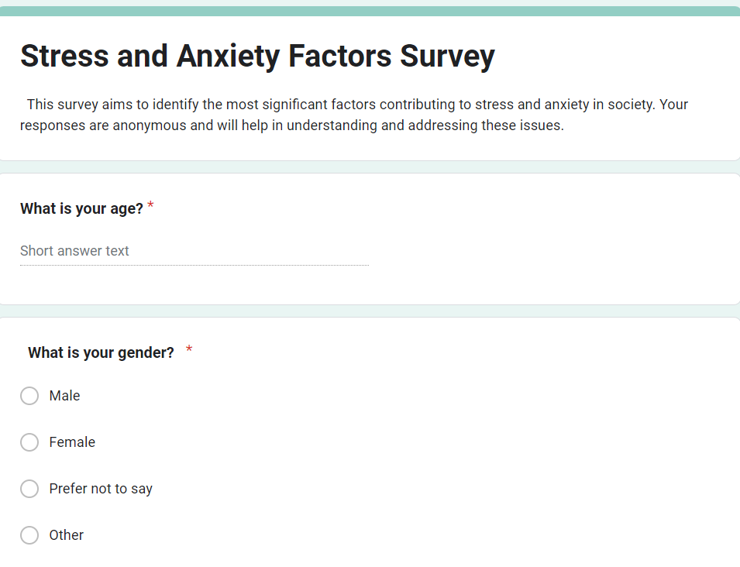
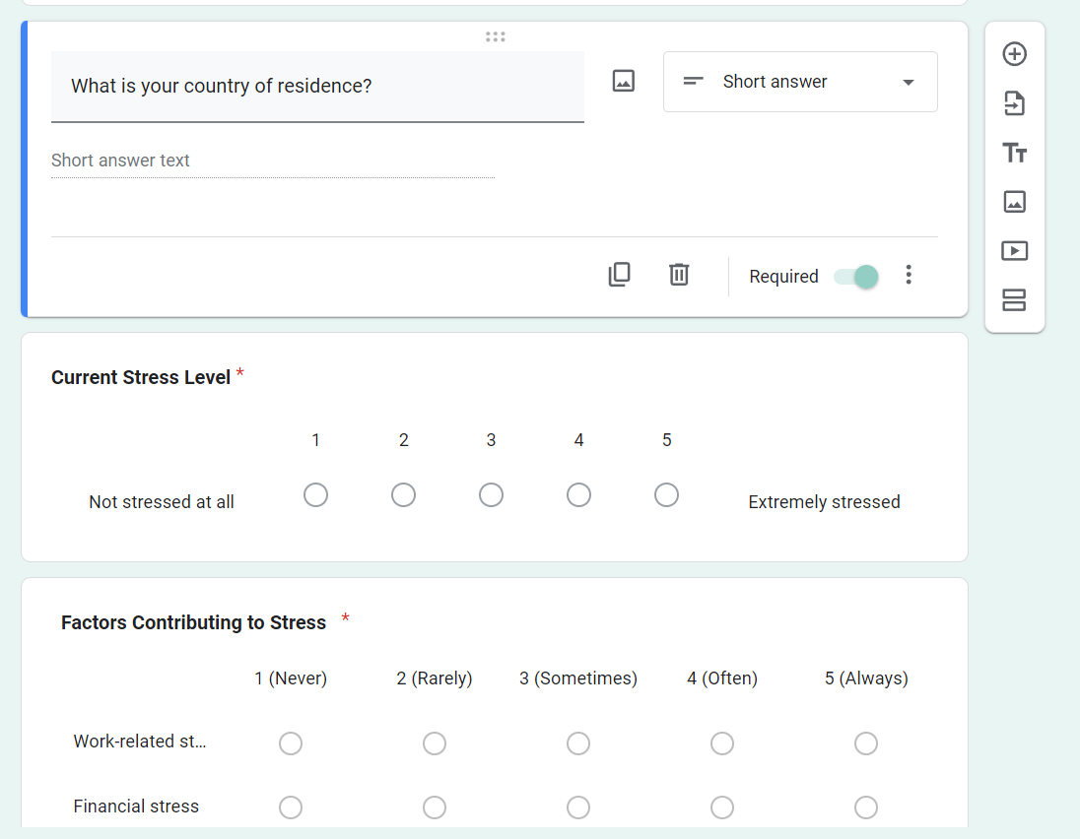
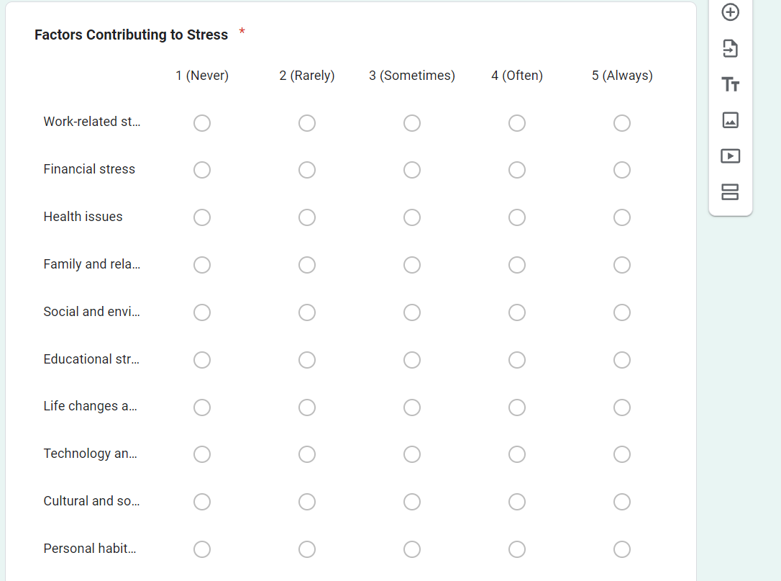
Attachments of the ongoing survey :

